Slide 1
IMDB Movie Analysis
Aaditya singh
trainity

Slide 2
Project Description
IMDB movie analysis dives into the world of film and television to give us answer to questions such as "What factors influence the success of a movie on IMDB?“ or “Do movies with longer duration have higher ratings?”.
The impact of this problem is significant for movie producers, directors, and investors who want to understand what makes a movie successful.
Which is why Data Analysis needs to be performed on this dataset to make informed decisions in their future projects.
Our objective is to solve any type of query that would arise and find data driven solutions to them.
The approach to this project is direct. Clean, analyze and visualize.
Notes:
Our project basically was to perform data cleaning and analysis on the imdb dataset provided and create meaningful insights which would help producers, directors and investors in their future projects.

Slide 3
Approach
On first looks, we can see that the dataset is unclean. So we need to first start cleaning the dataset.
The following steps were performed to aid in the data cleaning process-
Converted the dataset to a table and applied filter. Used the filter to remove all the rows with blank spaces.
Removed unnecessary extra character ‘A%’ from movie titles.
Removed unnecessary columns.
Removed duplicate rows.
Separated column ‘genre’ into multiple columns.
After all of this cleaning we can move up to the analysis part.
Notes:
Initially we need to clean the dataset, which means I converted to table
removed unneccessary columns- color, director_fb_likes, actor3_fb_likes, acto1_fb_likes, cast_total_fb_likes, faceno_poster, p
filtered the table and deleted all the rows with blank space
removed duplicates
changed data type of gross, budget

Slide 4
Approach
For analysis, some common steps I took in every task-
I would copy the columns into a new sheet for whatever attribute was required for the analysis. This made the analysis look more clean and readable.
Wherever possible, diagrams and plots were used for visualization purpose.
Some features like MEDIAN in pivot table were not available in my Excel version. So I had to take a more older route and use the formula.
All of the analysis was done in MS excel and pivot table was widely used.
Notes:
Now for excel I would create new sheets, kept the analysis clean, created visualizations.

Slide 5
Tech-stack used
I am using Microsoft® Excel® 2019 MSO (Version 2311 Build 16.0.17029.20028) 64-bit for this project.
MS excel is a spreadsheet application and has various use cases but its selling points are- creating Dashboards, Advanced formulas, Data Analysis and many more advanced features.
MS excel saves your work locally and on cloud servers and provides a brief visual interface.
To create a report I have used Microsoft PowerPoint 2019.

Slide 6
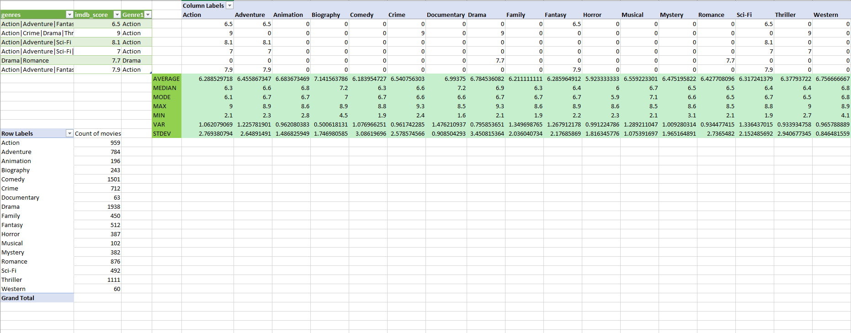
Insights
Task A: Movie Genre Analysis: Analyze the distribution of movie genres and their impact on the IMDB score.

Slide 7
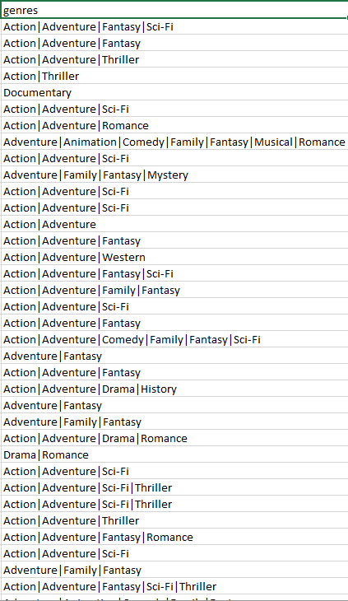
Insights
We were required to find the most common genre in the dataset which was done easily with the help of COUNTIF function.
The tricky part actually was that the genre column was unclean. It had slumped together all the genres together.
So, we needed to count the genres such that the word specified is taken into consideration and not just the first word of the cell.
The formula used was =COUNTIF(A3:A3846,"*"&A3854&"*"). Here A3:A3846 is the range, * is a wildcard character and & combines strings.

Slide 8
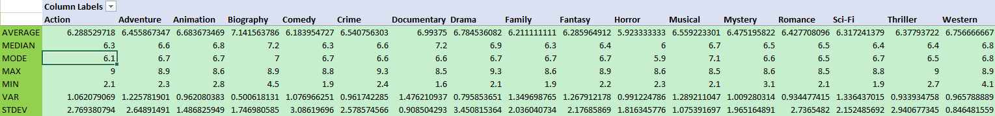
Insights
The rest of the statistics like AVERAGE, MEDIAN, MODE, MAX, MIN, VAR, and STDEV were found out easily using basic excel functions.
1 thing to consider here is that I had 0 values in my new table since all movies didn’t have all the genres. To tackle this, we specify our formulas to exclude 0 while calculating.
For example, to calculate AVERAGE we just have to specify “<>0”, which translates to don’t consider cells with the value 0 since it would skew the data and give us invalid answer.

Slide 9
Insights
Task B: Movie Duration Analysis: Analyze the distribution of movie durations and its impact on the IMDB score.
We straight away import 2 columns from our imdb dataset into a new sheet. These columns are of duration and score.
Then we apply descriptive statistics formula such as AVERAGE, MEDIAN and STDEV, to further help us in our analysis.
The scatterplot of Duration VS Score gives us some really great insight which would be later discussed in the result section.
This scatterplot is used to compare the 2 sets of values of data- duration and score.

Slide 10
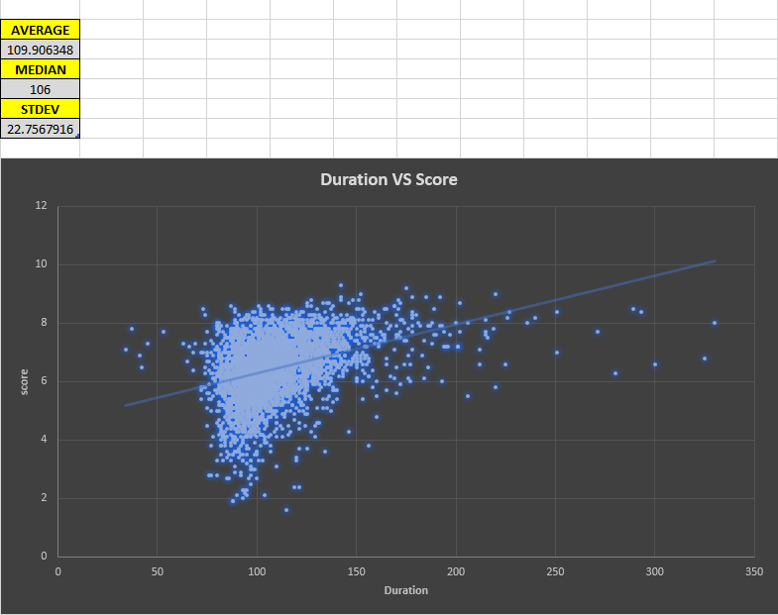
Insights

Slide 11
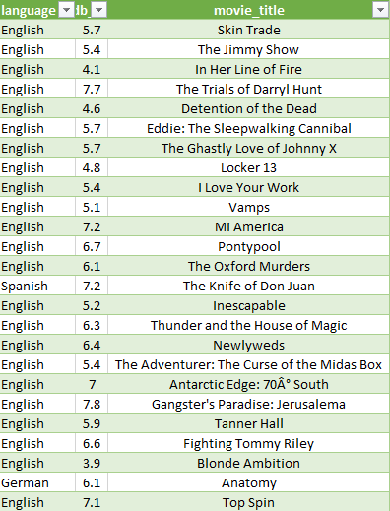
Insights
Task C:Language Analysis: Examine the distribution of movies based on their language.
Create a new sheet for a new task and import columns which are required, in this case- language, score and movie_title.
There are multiple films of the same language, we need the count of UNIQUE language. So, I have used a pivot table which will automatically only select unique values in the table.
Further we also calculate the COUNT of movies that unique language has.

Slide 12
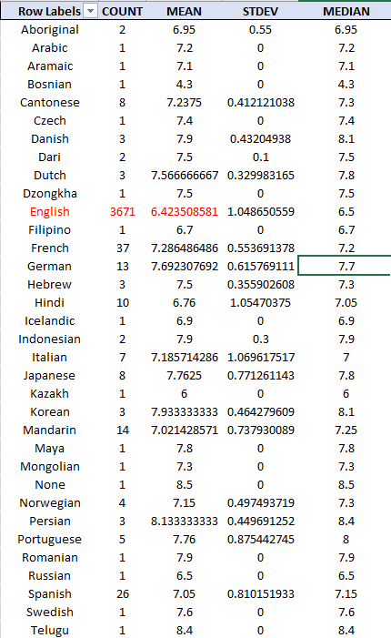
Insights
We make use of the pivot table to calculate COUNT, MEAN and STDEV since all these functions are pre-defined in our value field of pivot table.
The MEDIAN however, needed to be done using the formula since my pivot table did not have a pre-defined function called median in the pivot table.
The formula basically is =MEDIAN(IF($A$2:$A$3845=F15, $B$2:$B$3845)). Here, $A$2:$A$3845 is the language column range, F15 is the unique language name, $B$2:$B$3845 is the score column range and we tell excel to find out the median.

Slide 13
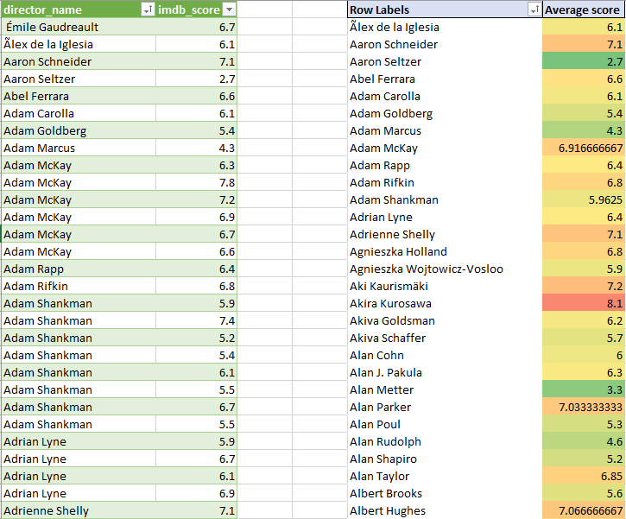
Insights
Task D: Director Analysis: Influence of directors on movie ratings.
Similar to our previous task, we have a problem here. Multiple movies have been directed by 1 single director. We need the count of UNIQUE directors. So, I have used a pivot table which will automatically only select unique values in the table.
Now moving further, we also calculate the average score using pre-defined AVERAGE function in pivot table field.

Slide 14
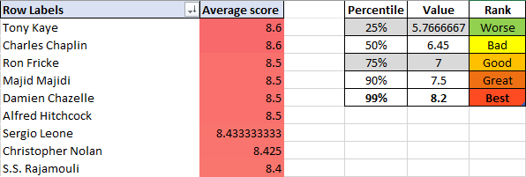
Insights
To find out how well a director has done on the basis of their average score for the entirety of their filmography, we use the PERCENTILE function along with a feature called Conditional Formatting.
We first find out the 25th, 50th, 75th, 90th and 95th percentile and give them certain colors to show the disparity between their values properly.
Conditional Formatting basically will apply colors accordingly as we have set it in our PERCENTILE table.
This will help us visualize which director has performed how well in their movie.

Slide 15
Insights
Task E: Budget Analysis: Explore the relationship between movie budgets and their financial success.
We import 3 columns- movie_title, budget, gross and change their data type to currency for readability purpose. Later we add our own column called profit_margin which basically is gross-budget in simpler terms. Profit_margin will give us an idea as to how well did a movie do and what was its R.O.I.
CORREL function of excel was performed which gives us a correlation coefficient between 2 cell ranges.
MAX function was used to find out the movie with the highest profit margin.
The scatterplot of Gross VS budget gives us a clear idea of which movies did how well on how much budget, it also provides a trendline for easier interpretation.

Slide 16
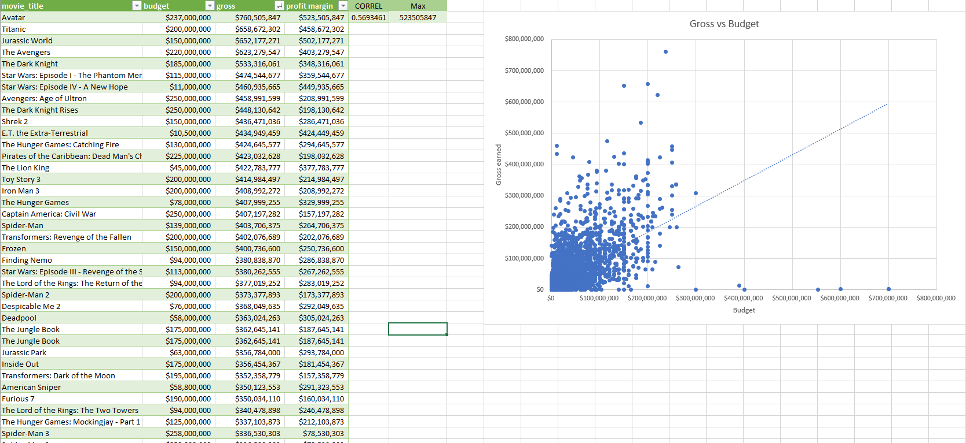
Insights

Slide 17
Results
Each task helped in better understanding of the data during analysis. We start by Movie Genre analysis which shows us which genre is the most common.
Drama genre is the most common genre with it being in almost 2000 movies, this is followed by Comedy genre with it being used in 1500 movies. The least used genre in films are Western genre with only 60 movies using it.
Biography had the Highest AVERAGE score, MEDIAN and MODE. But MAX rating was given to crime and drama genre.
Biography had the lowest variance and Documentary had the highest variance. So, biography genre has received a good average score and documentary genre average score is quite spread out.
The comedy genre has the highest STDEV which indicates that it has higher score compared to the mean whereas documentary genre only has a score of 0.90 which is low and their imdb scores are closer to the mean.

Slide 18
Results
The Average movie duration time was ~110 minutes. The most common runtime of movies was 106 minutes.
While analyzing the scatterplot a trendline forms with increasing duration and score which suggests that even though the duration of movie increases there is no direct correlation to its score increasing.
We also see that there majority of movies are made in between 75 minutes to 150 minutes duration format. There score also is between 5 to 8.

Slide 19
Results
English Language has the record for highest movies ever made in 1 language which is 3671 (according to our dataset). The highest mean score that a language has is Telugu with 8.4 score.
The mean of Italian language is 1.06 which is the highest and the lowest is Dari which is 0.1. Multiple languages only had 1 film and their STDEV was 0. The highest median was for Persian language which was 8.4
The best directors Tony Kaye and Charles Chaplin boasted AVERAGE score of 8.6 and the worst score received was 2.1.
The movie with the highest profit margin was Avatar with a whopping value of $523,505,847.
The CORREL function returned the value 0.5693461 which is not a strong positive correlation.
The scatterplot also indicates that maximum movies are shot with a budget of >$200,000,000 and their Gross earning is also around that number.
Very few movies have low budget and skyrocket in gross earnings. Similarly, no movies have been made with a high budget that have returned the same amount of money in gross earnings.

Slide 20
Drive Link
IMDB movie analytics Excel sheet
IMDB movie analysis video presentation

